Slide 1

Varendra University
Dept. of Computer Science & Engineering (CSE)
MDA-8086 Trainer Kit
Course Title: Microprocessor and Assembly Language Lab
Course No: CSE 3206
Prepared By:
Md. Adnan Sami
Lecturer, Dept. of CSE, VU

Slide 2
Outline
  Introduction.
  Features of MDA-8086/Main Components.
  Memory.
  Power Section.
  8255 Programmable Peripheral Interface (PPI).
  Input Devices.
  Function Key.
  Output Devices.
  Interfacing Chips.
  Programming Method.
  Why 8255 is Needed?
  Internal Registers of 8255.

Slide 3
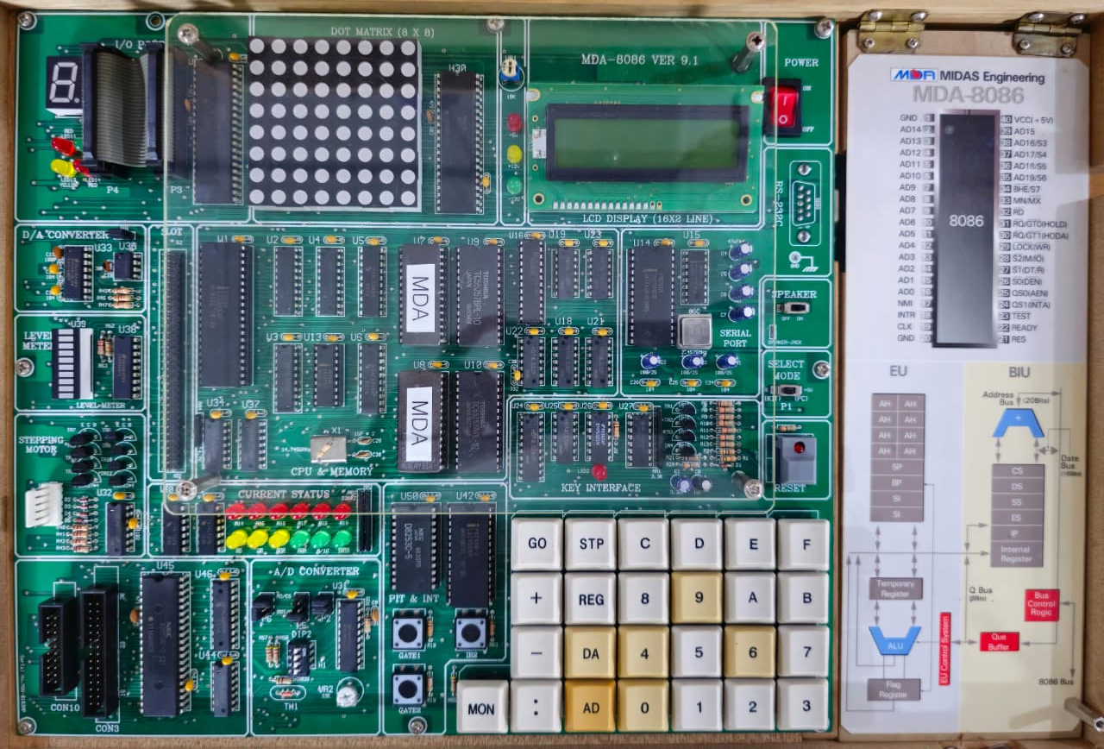

Slide 4
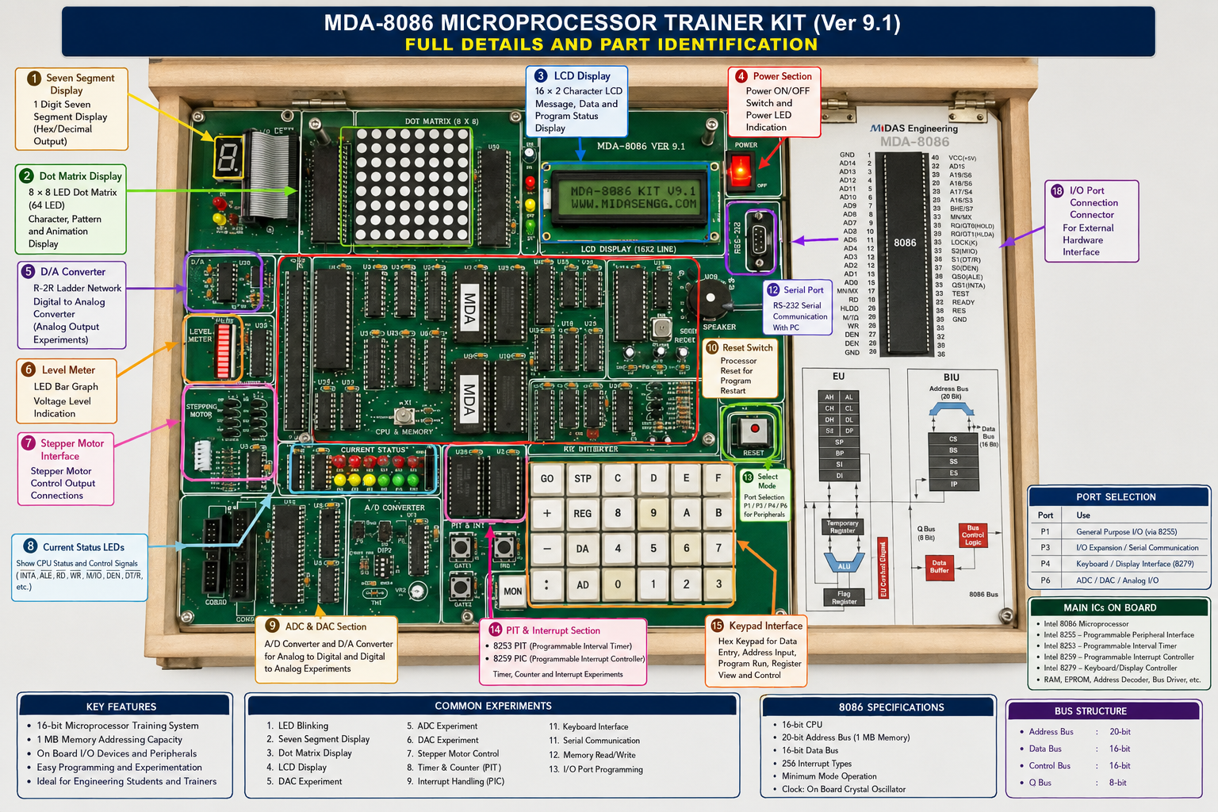

Slide 5
Introduction
MDA-8086 is an 8086 Microprocessor Trainer Kit designed for learning and practicing 8086 Assembly Language Programming and Hardware Interfacing.
Manufacturer: MIDAS Engineering
Model: MDA-8086 Version 9.1

Slide 6
Features of MDA-8086/Main Components
  Intel 8086 Microprocessor Based Trainer
  16-bit CPU
  20-bit Address Bus
  16-bit Data Bus
  1 MB Addressing Capability
  Monitor Program (ROM Based)
  RAM for User Program
  Hexadecimal Keypad
  Seven Segment Display
  LED Interface
  Dot Matrix Display
  LCD Display
  Stepper Motor Interface
  ADC/DAC Interface
  8255 Programmable Peripheral Interface
  Standalone Operation (Programs can be executed without a PC)

Slide 7
Memory
  EPROM (Stores Monitor Program)
  RAM (Stores User Program)

Slide 8
Power Section
  Power Switch (ON/OFF, Power LED)
  Reset Switch (To reset the processor, To start program from the beginning)

Slide 9
8255 Programmable Peripheral Interface (PPI)
  The Trainer Kit uses two 8255 Programmable Peripheral
  Interface (PPI) chips.
  8255 (CS2) [Chip Select 2]
  Connected with:
    LED
    7-Segment Display
    Stepper Motor
  8255 (CS1) [Chip Select 1]
  Connected with:
    Dot Matrix Display
    ADC/DAC Interface

Slide 10
8255 Programmable Peripheral Interface (PPI)
  The function of the 8255 is,
  8086 ↔ Peripheral Device Communication

Slide 11
Input Devices
  Keypad Interface:
    Hexadecimal Keypad: 0–9, A–F
    Function Keys: GO, STP, REG, MON, DA, AD
    Others: +, -, :
  Uses:
    Program Input
    Provide Memory Address
    Data Entry
    View Register
    Program Run

Slide 12
Function Key
Function Key | Full Form | Function
MON | Monitor | To enter the Monitor Program. From there, memory, registers, programs, and other system functions can be controlled.
GO | Go | To execute a program from a specified memory address.
REG | Register | To view or modify the CPU registers (AX, BX, CX, DX, CS, DS, ES, SS, IP, SP, FLAGS, etc.).
AD | Address | To select the memory address where you want to view or write data or machine code.
DA | Data | To input or modify data or machine code at the selected memory address.
STP | Step / Stop | To execute the program step by step (Single Step) or stop a running program.

Slide 13
Output Devices
  4 LEDs
  Seven Segment Display
  8×8 Dot Matrix Display
  16×2 LCD Display
  Speaker

Slide 14
Interfacing Chips
  8255 PPI
  ADC
  DAC
  Stepper Motor Driver

Slide 15
Programming Method
  Assembly Program
  ↓
  Assemble
  ↓
  Machine Code
  ↓
  Input into Monitor
  ↓
  Execute using GO
  ↓
  Output appears on Hardware

Slide 16
Why 8255 is Needed?
  No GPIO (General Purpose Input/Output) Port in 8086. So,
  8086 → 8255 → Hardware
  GPIO is an I/O pin that can be configured by software to function as either an input or an output.
  8086 Microprocessor does not have built-in GPIO ports. Therefore, external I/O interface chips such as the 8255 PPI are required to communicate with external devices like LEDs, seven-segment displays, LCDs and keypads.

Slide 17
Internal Registers of 8255
  8255 has four registers,
Register | Function
Port A | Input/Output Port
Port B | Input/Output Port
Port C | Input/Output Port
Control Register | Configuration Register

